Slide 1
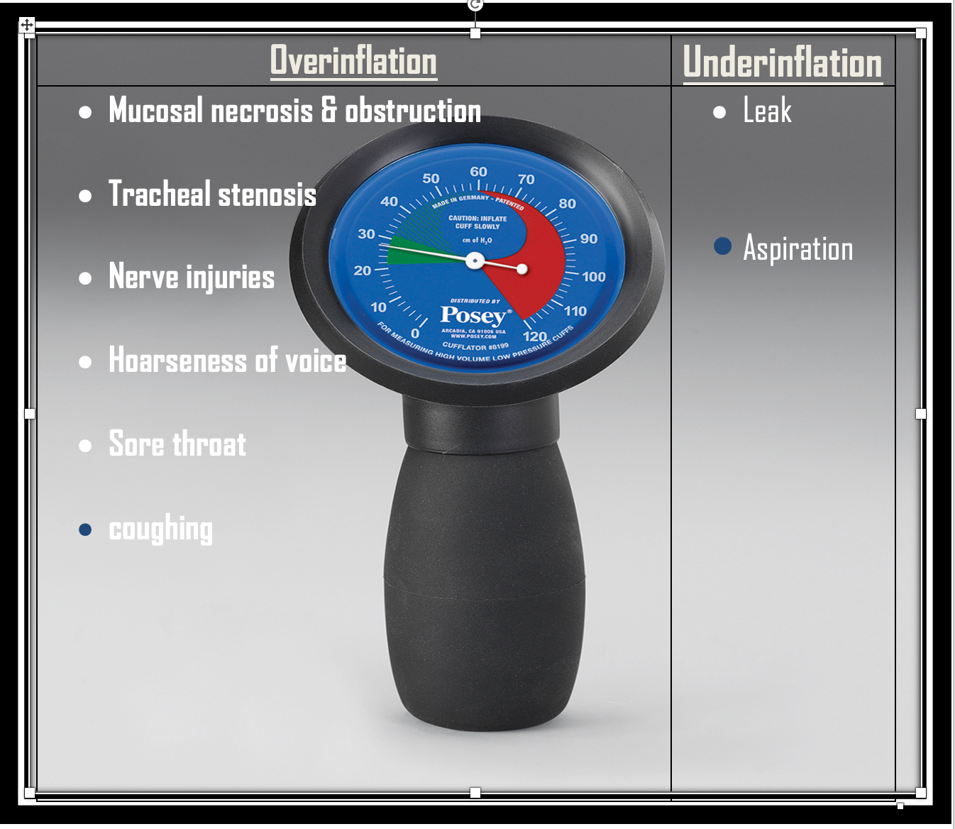
Measurement of endotracheal tube cuff pressure and the incidence of post-operative sore throat.
Dr Michael Nesbitt (ST5 anaesthesia), Dr Shivan Kanani, & Dr Gautam Modak (ST4 anaesthesia). Project supervisor – Dr Amr Ali.
Kings Mill Hospital, Sherwood Forest Hospitals NHS Foundation Trust.
Introduction
Methods
Results
There are risks associated with both over- and under-inflation of the endotracheal tube cuff (figure 1).¹ Despite this, there is a lack of national guidelines on the optimal cuff pressure. General consensus is that a target pressure of 20-30 cmH20 is appropriate. ²
Cuff pressure manometers were installed in each theatre.
Posters were produced and displayed in each anaesthetic room (figure 1).
Inclusion criteria – adult patients, intubated for surgery.
Round 1 data collection – prospective data collection, July-August 2022. 30 patients. Audit of the presence (yes/no) and severity (numerical scale 1-10) of sore throat in recovery.
Teaching delivered to ODP’s regarding the importance of cuff pressure measurement.
‘Tick’ stickers were introduced in theatre to signify cuff pressure had been checked and was within the target range.
Round 2 data collection – prospective, December 2022 – January 2023. 25 patients. Audit of the presence and severity of sore throat in recovery (as above).
Round 1. 16/30 patients (53%) described a sore throat in recovery. Mean sore throat severity score 3.7/10.
Round 2. 11/25 patients (44%) described a sore throat in recovery. Mean sore throat severity score 4.3/10.
Conclusion
Routine measurement of endotracheal tube cuff pressure, with a target pressure of 20-30 cmH20, may reduce the incidence of post-operative sore throat.
There were some barriers to the use of the cuff pressure manometers. We adopted a step-wise approach to overcome these, designing posters to raise awareness and delivering teaching to colleagues.
The introduction of ‘tick’ stickers provided a reminder to check cuff pressure and was successful in promoting routine cuff pressure measurement in theatre.
³
Acknowledgements
Figure 1. Poster produced to highlight the potential complications associated with cuff over- and under-inflation, for display in the anaesthetic room.
Many thanks to our anaesthetic colleagues and ODP’s for diligently checking cuff pressure. Thanks also to our recovery staff for assisting with data collection.
Project aims
References
To introduce routine cuff pressure measurement in theatres, targeting a pressure of 20-30 cmH2O.
To audit the incidence and severity of post-operative sore throat in recovery.
1) Kumar CM, et al. Measuring endotracheal tube intracuff pressure: no room for complacency. J Clin Monit Comput 2021;35:3–10.
2) Sole ML, et al. Evaluation of an intervention to maintain endotracheal tube cuff pressure within therapeutic range. Am J Crit Care 2011; 20 (2):109–118.
Figure 2. The number of patients reporting a sore throat in recovery, during each round of data collection.

